Slide 1

Minor Project Corporate Recruitment System
Maulana Azad National Institute of Technology, Bhopal
Project By
Udit Narayan Dixit
Chahat Gupta
Mayank Agrawal
Submitted to
Dr. G.S. Thakur
Notes:
When listing all project collaborators, either use commas or bullets

Slide 2
Index
Introduction
Overview of Data
Methods
Results
Result with variation of Dropout
Acknowledgement
Conclusion and Future Scope
Notes:
Insert a map of your colony (draw it, ink it, or create it in PPT- be creative!)
Insert -> Pictures for photos
Draw for digital inking
Insert -> Shapes if you want to create it in PPT
All mountains, towns/villages, bodies of water/waterways, landmarks, etc. should be clearly labeled

Slide 3
Introduction
A corporate recruitment system is a web-based application that helps to automate the process of hiring.
The Corporate Recruitment System is more than just a tool,it's an integrated approach to talent acquisition. Rooted in the latest HR technologies and insights, CRS offers a holistic solution to the challenges of hiring in the digital age.
CRS's analytics module provides a deep dive into recruitment metrics, helping HR teams understand patterns, foresee challenges, and optimize strategies.
Our system effortlessly integrates with your existing HR software, ensuring a smooth transition and uninterrupted workflows.

Slide 4
Proposed Objectives
Optimize Recruitment Efficiency
Streamline the entire recruitment process from job posting to candidate onboarding to ensure timely and efficient hires.
Improve Candidate Experience:
Provide a user-friendly, transparent, and seamless application process, ensuring timely communication and feedback for all applicants.
.
Integrate with Existing Systems:
Ensure seamless integration with existing HRM systems and software, thereby maintaining data integrity and minimizing operational disruptions.
Ensure Confidentiality:
Maintain a secure environment to protect both company and candidate data.
Cost Efficiency:
Reduce recruitment-related costs through automation, minimizing manual tasks, and reducing hiring missteps.
Expand Talent Pools:
Cultivate and maintain a diverse and expansive talent database to ensure a continuous flow of qualified candidates for various roles.
Notes:
Think about the questions listed above and answer them.
Can you think of anything else in regards to economy and trade that you would like to add?

Slide 5


Overview of Data
Application Data
Application status
Assessment scores
User Data
(for internal staff)
Recruiter profiles
Hiring manager details
User activity logs, including reviews, edits etc.
System Metadata
Login and Logout Timestamps
Data Timestamps
Candidate Data
Personal Information
Resume and CV
References
Job Posting
Job title
Role description
Required qualifications
Salary and benefits
Notes:
Use the SmartArt to determine the flow of government/leadership:
Who leads the colony (executive)? What is that person/are those people’s duties?
Who makes the rules (legislature)?
Who ensures the rules are followed (judicial)?
Are there any other branches of government? If so, who are they and what is their job?
To add more shapes, click on the left shape first, then on SmartArt Tools -> Design -> Add Shape After
Do the same for the shape to the right
Feel free to rename the branches!

Slide 6
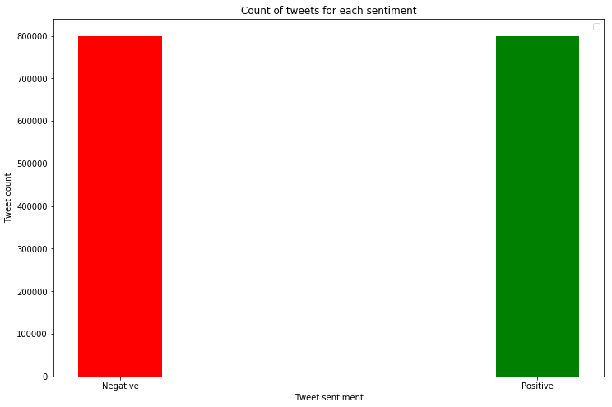
Methods and Materials
1. Data Collection:
Twitter dataset is collected from Kaggle repository (sentiment140) and analyzed for positive and Negative targets. Figure Shows the number of tweets with positive and negative sentiments. These are roughly the same.

Slide 7
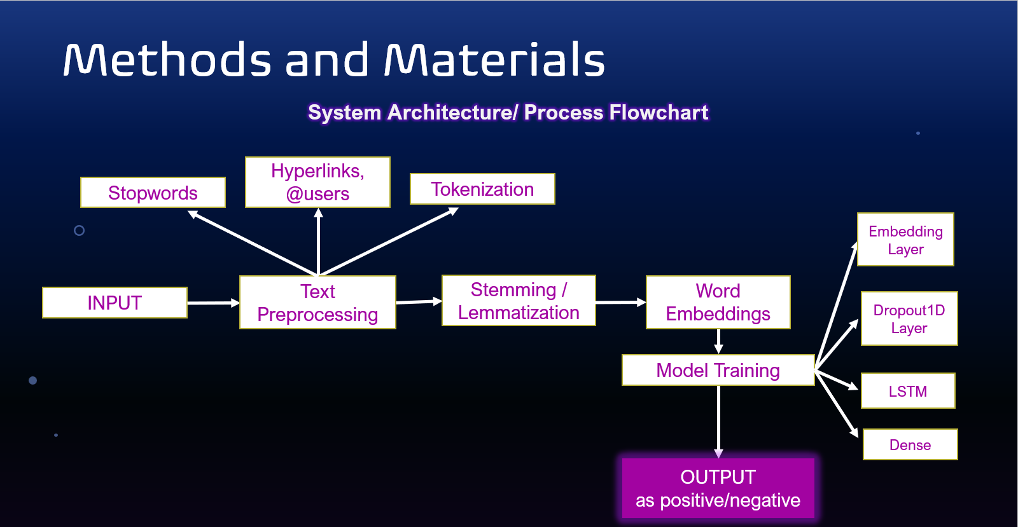

Slide 8
Methods and Materials
2. Data Preprocessing:
The data preprocessing includes a set of operations to be performed on the dataset to extract sentiments. It cleans the tweets by removing stop words, spacing, or any special symbols. The processed data is further used for the model training and testing. Following are the operations done under data preprocessing:
Remove user mentions in form of @user.
Remove non-alphabetic characters + spaces + apostrophe
Remove links
Remove single characters
Remove Stopwords (words with no logical meaning such as ‘is’)
Lemmatize words
Stem words

Slide 9
Methods and Materials
Stemming:
Stemming is used to reduce words to their base form, also known as the root form. The process of stemming is used to normalize text and make it easier to process. A stemming algorithm reduces the words “chocolates”, “chocolatey”, and “choco” to the root word, “chocolate”.
from nltk.stem import PorterStemmer
Lemmetization:
In contrast to stemming, lemmatization is a lot more powerful. It looks beyond word reduction and considers a language’s full vocabulary to apply a morphological analysis to words, aiming to remove inflectional endings only and to return the base form of a word, which is known as the lemma.
It normally remove unnecessary endings of word and to provide the actual form of a word as per the dictionary.
from nltk.stem import WordNetLemmatizer

Slide 10
Methods and Materials
3. train-test-split:
After cleaning the data, the data is split into the training and the testing data, we are using the ratio of 80:20 to split the data.
The data is taken from the csv format using pandas.
And after the split the data is again stored in the two files, train and test that will be used further.

Slide 11
Methods and Materials
4. Model Training:
In Sequence model Architecture, we are Implementing following Layers :
Embedding Layer- This layer helps in creating vectors using predefined library.
SpatialDropout1D- The Dropout layer randomly sets input units to 0 with a frequency of rate at each step during training time, which helps prevent overfitting.
LSTM- LSTM stands for Long Short Term Memory, it’s a type of RNN which hold memory state cell to learn the contextual meaning of words which further get transferred with neighboring word unlike RNN where it only transfers neighboring word.
Dense- This layer is a deeply connected neural network helps in training model.

Slide 12
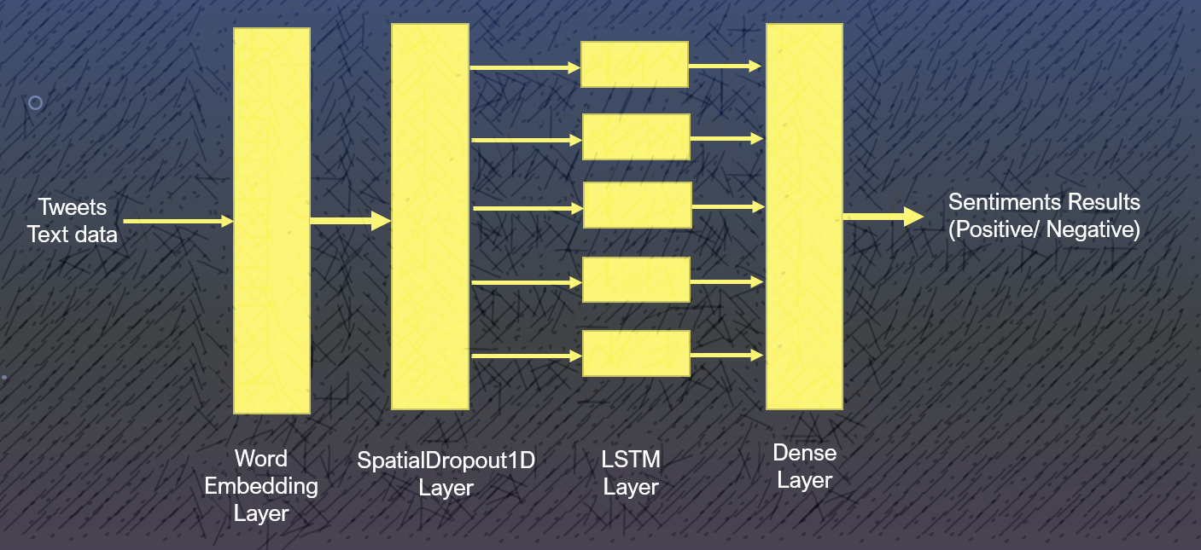
Methods and Materials
4. Model Training:

Slide 13
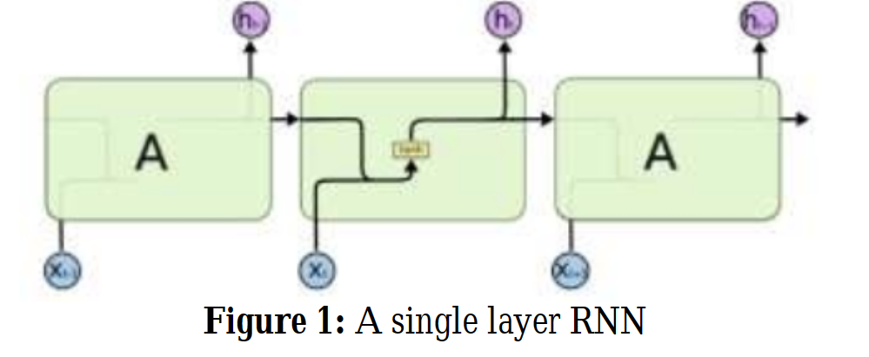
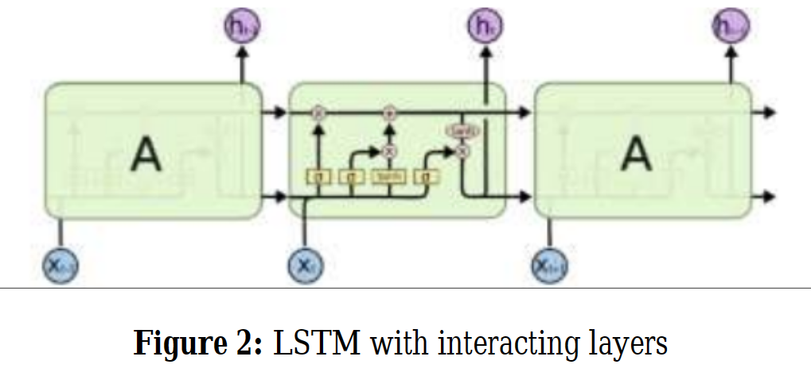
Materials… contd
Difference between RNN and LSTM

Slide 14
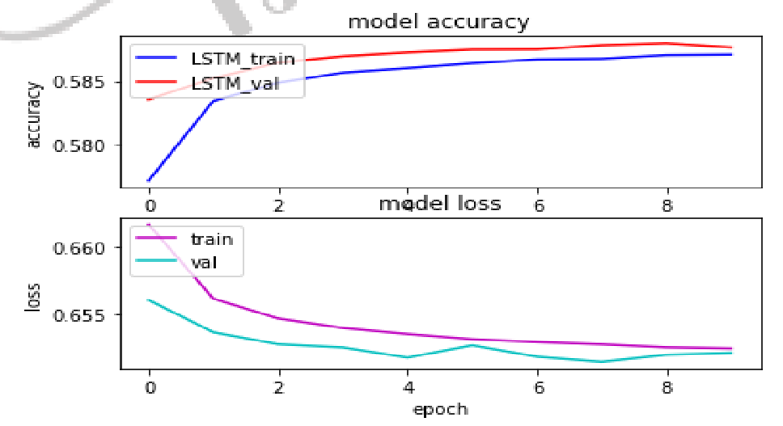
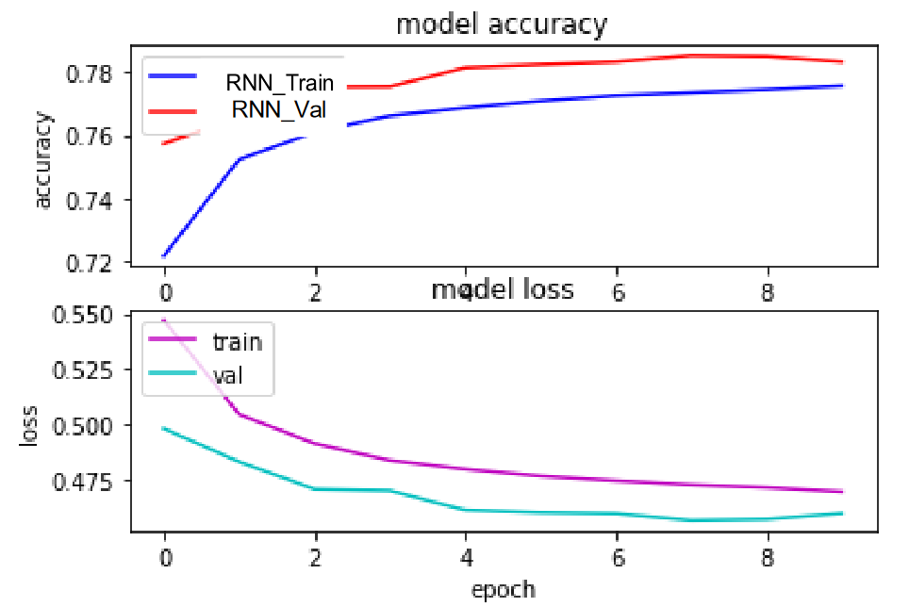
Materials… contd
Performance of CNN and RNN
CNN with Accuracy: 58.69%
RNN with Accuracy: 77.73%

Slide 15
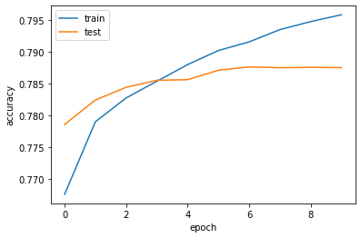
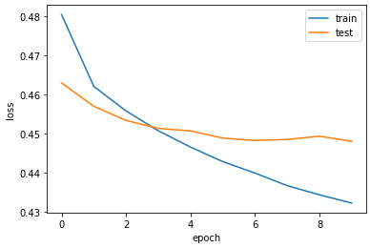
Results
As of now, the entire model is trained on only 10,24,000 tweets and being tested on 2,56,000 tweets, using cross validation while training, accuracy is around 80.99%. The accuracy and loss in the sequential model can be shown in the given Figure.
Accuracy
Loss

Slide 16
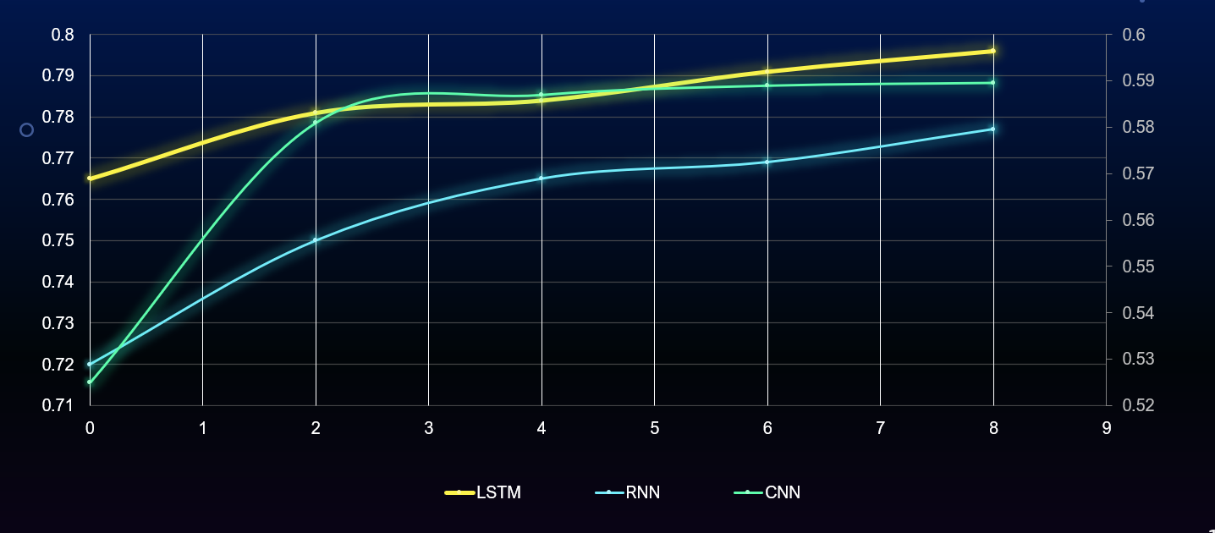
Comparison with CNN and RNN

Slide 17
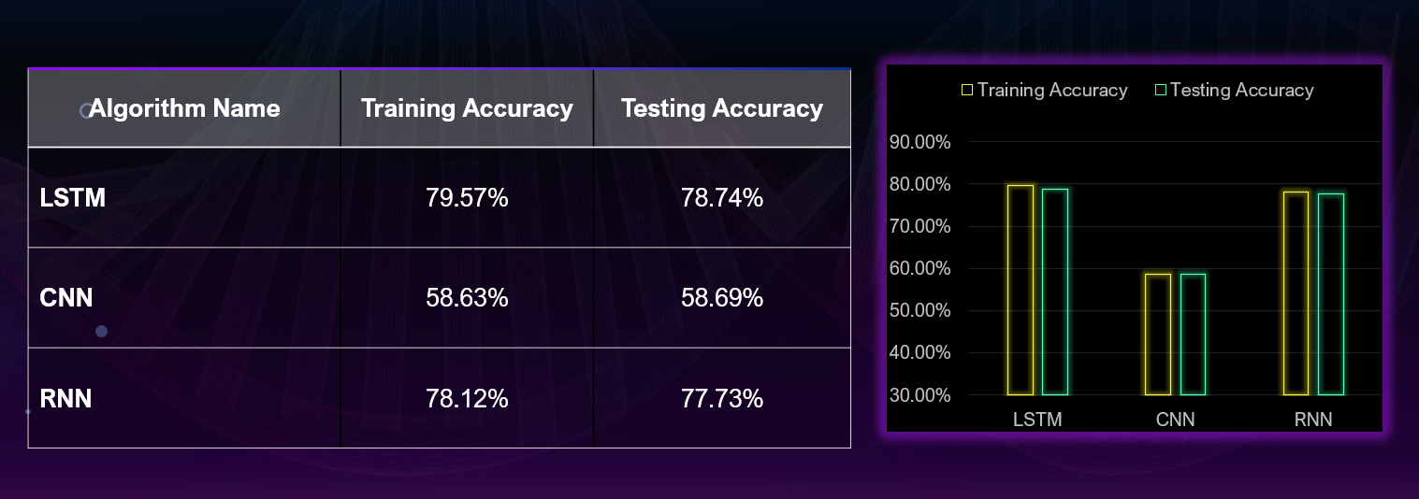
Comparison with CNN and RNN

Slide 18
Conclusion
Our proposed research work tested the accuracy of LSTM model. CNN based approach results into 58% accuracy, while the RNN model results into 77% accuracy.
To conclude, our model has resulted into better accuracy than both of the above model being more than 78% accurate.
The 78% accuracy level is one of the best among the popular approaches to sentiment analysis.
We have also tested our model with a variety of epochs and batch sizes, the model gradually performs better with each epoch.
Also the lesser the size of batch, the better the model performs. Batch size 10 and 128 epochs result into 82% accuracy while batch size 128, and epoch 10 result into 78% accuracy level.
Notes:
What is the name of your colony song?
Write lyrics to the song and, if you are feeling creative, use a computer program or instruments to create the music that goes along with it!
To insert an audio file, click on Recording -> Audio -> Audio on My PC and choose your file

Slide 19
Future Work
In this project, there can be successful analysis of multiple tweets showing their sentiments as positive or negative. Technologies such as HTML, CSS can be used for creating the user interface of the main project, MySQL/SQLite can be used for database management, and Natural Language processing is used for determining texts used in tweets.
Efficient handling of tweets for the user, using a user-friendly Interface can be done. Still, there is certain limitations regarding this project such as it works only in one language i.e English.
Also, new data is generating rapidly and thus no one can rely on old data to predict today’s people sentiment.
A mix of Convolutional and LSTM Model for sentiment Analysis can also perform better if optimized.
Notes:
What is the name of your colony song?
Write lyrics to the song and, if you are feeling creative, use a computer program or instruments to create the music that goes along with it!
To insert an audio file, click on Recording -> Audio -> Audio on My PC and choose your file

Slide 20
References
Brijesh Bakariya and G.S. Thakur, "An Efficient Algorithm for Extracting Infrequent Itemsets from Weblog", The International Arab Journal of Information Technology (IAJIT),2019 (2)
Brijesh Bakariya and G.S. Thakur, "Mining Rare Itemsets from Weblog Data",National Academy Science Letters, 2015 page 1-5
Brijesh Bakariya and G.S. Thakur, "Pattern Mining Approach for Social Net-work Service", National Academy Science Letters, June 2017, Volume 40, Issue 3, pp 183–187
Brijesh Bakariya, G.S. Thakur,"An Efficient Algorithm for Extracting High Utility Itemsets from Web Log Data",published in The Institution of Electronics and Telecommunication Engineers (IETE) Technical Review SCI DOI: 10.1080/025646 02.2014.1000396, Volume-32, Issue-02, March- 2015, Pages 151-160. ISSN 0256-4602 impact factor1.304
C. Liu, K. Li, K. Li, and R. Buyya, “A new service mechanism for profit optimizations of a cloud provider and its users,” IEEE Trans. Cloud Comput., vol. 9, no. 1, pp. 14–26, Jan.–Mar. 2021
D. S. Rajput, R. S. Thakur, G. S. Thakur, “A Computational Model for Knowledge Extraction in Uncertain Textual Data using Karnaugh Map Technique”, International Journal of Computing Science and Mathematics (InderScience) ISSN: 1752-5055, Jan 2016, Vol. 7, Issue 2, pp. 166-176
D.S Rajput, R.S. Thakur and G.S. Thakur, “Fuzzy Association Rule Mining based Frequent Pattern Extraction from Uncertain Data” presented in IEEE 2nd World Congress on Information and Communication Technologies (WICT- 2012) October 30-November 02, 2012 in IIITM Trivandrum, ISBN: 978-1-4673-4804-1 pp 709-714
D.S Rajput, R.S. Thakur, G.S. Thakur, “An Integrated Approach and framework for Document Clustering using Graph based Association Rule Mining” published in Advances in Intelligent Systems and Computing, Springer, ISBN 978-81-322-1602-5, Vol. 236 pp. 1421- 1438.
G. S. Thakur,Fuzzy Soft Trafﬁc Accident Alert Model,National Academy of Science Letter(May–June 2014),Springer 37(3):26 1–268 DOI 10.1007/s40009-014-0235-6
G. Vishwakarma and G. S. Thakur, “Hybrid System for MPAA Ratings of Movie Clips Using Support Vector Machine,” in Advances in Intelligent Systems and Computing book series (AISC, volume 817), 2019, pp. 563–575
G.S. Thakur,Neeraj Sahu,Swatranta Sahu,“Hesitant Fuzzy Linguistic Term Set Based Document Classification” ,In IEEE Third International Conference on Communication Systems and Network Technologies April 6-8,2013,Gwalior,India
G.S. Thakur,R.S. Thakur, “Design of 2-Level Clustering Framework for Time Series DataSets”, In an International Conference on Soft Computing for Problem Solving (SocPros11) ,IIT Roorkee India, December 16-18, 2011, Published Springer Proceeding.
Aniket Kale, Chetan Bawankule, Payal Singanjude, Ganesh, Twitter Sentiment Analysis using LSTM Algoritghm
Notes:
What is the name of your colony song?
Write lyrics to the song and, if you are feeling creative, use a computer program or instruments to create the music that goes along with it!
To insert an audio file, click on Recording -> Audio -> Audio on My PC and choose your file

Slide 21
Thank You!

